Slide 1
COVID-19: Impact on kids and schools

Slide 2
COVID-19: Overall less disease burden among kids
Nationwide, adults make up nearly 95% of reported COVID-19 cases
6.6% of reported COVID-19 cases are among adolescents <18 years of age
Less than 0.1% of COVID-19-related deaths are among children and adolescents less than 18 years of age in the United States.
Reports suggest children are less likely to get COVID-19 than adults (especially children <10 years of age), and when they do get COVID-19, they generally have a less serious illness.
Recent study in Science (Zhang et al) estimated kids <14 years of age to be ~2/3 less susceptible to infection
Notes:
MIS-C
Targeted surveillance for MIS-C from March 15 to May 20, 2020 • 186 patients with MIS-C in 26 states • 31% Hispanic or Latinx, 25% Black/African American • 71% had involvement of at least 4 organ systems • 80% ICU, 20% mechanical ventilator • As of May 20, 70% discharged alive, 28% still hospitalized, 4% died
Source: https://www.nejm.org/doi/full/10.1056/NEJMoa2021680

Slide 3
COVID-19: Infectiousness of kids: Conflicting findings
In general, household contacts more than 10 fold likely to develop infection compared to non-household contacts
In household clusters, the index case is more often an adult, rather than a child
Among household contacts
If index case is 0-9 years of age: ~½ as likely to lead to transmission to others
If index case 10-17: transmission rates appear similar to adults
Among non-household contacts
Highest rates of transmission when index case was 40 or older
Notes:
Multiple studies suggest that young children have lower rates of infection than older children and adults
• Geneva: Ages 5-9 risk was 32% that of adults age 20-49 and no significant difference between 10-19 yo and 20-49 yo
• Iceland: Age < 10: 6.7% positive, Age > 10: 13.7% positive Increased gradually from 10-20 years

Slide 4
COVID-19: Transmission in schools
Sporadic outbreaks and clusters have been reported in schools, but less common than other congregant settings
Studies suggest outbreaks more likely to occur in high school age children compared to younger age groups
Uncertainties:
If transmission occurring in school vs out of school activities (ie-if really a cluster)
When community level burden is high, chance of exposure outside of school likely higher than in school
What primarily drives cluster (kids vs adult as index case)
If spread among kids in school settings any greater than kids congregating outside of school in other activities
Controlled settings with enforced mitigation should have lower transmission
Study in France:
510 students from six primary schools were included in the study.
There were three probable cases of SARS-CoV-2 infection in three different schools before the schools closed. These cases did not give rise to secondary cases among other school students or teaching staff.
Notes:
Denmark reopened schools to students in mid-April with little impact on transmission. Same was true in Finland. Openings were staggered by age.
• Israel reopened schools in May, 244 new infections among children and school personnel (130 at a single school). Surging cases at the time of reopening.
• As of July 6 in Texas, over 1300 cases in over 800 child care facilities (894 staff; 441 children)
• In July, a camp in Missouri closed after 41 campers and staff were infected; 4 days later, 82 total infections reported

Slide 5
COVID-19 compared to seasonal influenza
Variable | COVID-19 | Influenza
Overall burden in US | 4.0 Million lab confirmed (If assuming only 1 out of 10 are diagnosed, closer to ~40 Million cases) | 9.5-45.0 Million cases annually (estimated)
% of cases among children | 6.6% | 2018-2019: 31.8% were among kids
% of deaths occurring among children | <0.1% | 2018-2019: 1.4%
Transmission | Less certainty, but to date, younger kids not a major driver of transmission | Kids known to play a large role in transmission
Notes:
CDC: students spaced 6 feet apart when feasible
• AAP: spacing as close as 3 feet may approach the benefits of 6 feet of space, esp. with face coverings and no symptoms
• Lancet, June 1: review of 172 studies across 16 countries and six continents found risk of infection by keeping a distance of 3 feet or more was 3% versus 13% with distance less than 3 feet. Source: https://www.thelancet.com/journals/lancet/article/PIIS0140-6736(20)31142-9/fulltext

Slide 6
CHICAGO EXPERIENCE: COVID-19, childcare, camps, schools
CHILDCARE CENTERS and CAMPS July 5th-July 25th:
Cases and clusters at childcare centers and camps are required to report cases and clusters to CDPH
Cases among staff and kids have reported to CDPH
Nearly all were staff members/adults
Few facilities with more than 1 case
Most kids had known household exposures to a positive COVID-19
No definitive 2ndary cases among kids
VAUGHN SCHOOL:
Vaughn closed March 6, 2020 following the identification of a laboratory-confirmed case in a teacher’s aide who worked while sick with students aged 14–22 years with cognitive and developmental disabilities.
Over 400 contacts identified and monitored; all quarantined
No known 2ndary cases at school identified
Only known 2ndary cases occurred among household contacts of the index case
Notes:
6 pediatric cases include 2 single cases at daycares (7 months and 2 yo, reflecting community transmission) with no secondary transmission identified to date, an 8 month old infant case (likely household transmission, mom + 1 day before baby, HCW at home), 2 siblings (possible secondary transmission from infant case but unlikely and rest of family positive concurrently), 1 child (possible secondary transmission from an adult daycare staff, more likely community transmission due to no epi link to teacher but cannot rule out).
Children reported to be positive but who did not attend daycare during their infectious period and for which no other known cases had occurred at the daycare were excluded.(n=2)
I-NEDSS matching to contact lists on 7/25 identified one additional adult case included above. This does not rule out identifying infection for contacts still completing their incubation period.

Slide 7
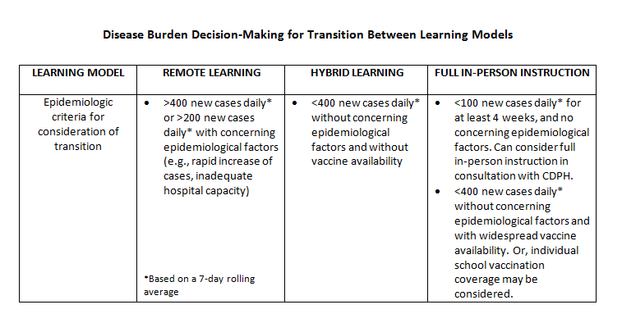
Tracking COVID-19 Disease Activity to Make Decisions

